Slide 1


SP3176 The Universe Chapter 2: Falling Apples and Orbiting Planets
Lim Zhi Han

Slide 2
Learning Objectives
At the end of this lesson, you should be able to understand how dynamical situations can be modelled with differential equations (DEs). You will be able to solve some simple DEs analytically and numerically. The ultimate task is to solve the three-body (gravitational system) problem using Newton's laws.

Slide 3
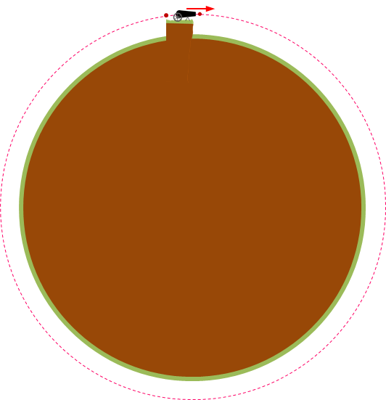
The apple, the cannonball and the Moon
There is a cannon on a cliff…
What if even greater firepower is used?
Notes:
Get a student to present.

Slide 4
“Science is a differential equation. Religion is a boundary condition.” – Alan Turing

Slide 5


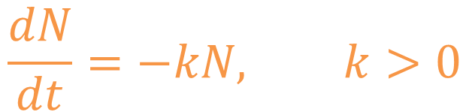
Differential Equations model things that change
Beer foam are bubbles.
Bubbles pop.
Number of bubbles $N$ is decreasing with time.
More bubbles, more popping.
$$\frac{dN}{dt}=−kN, k>0$$
Image: Flaticon.com

Slide 6
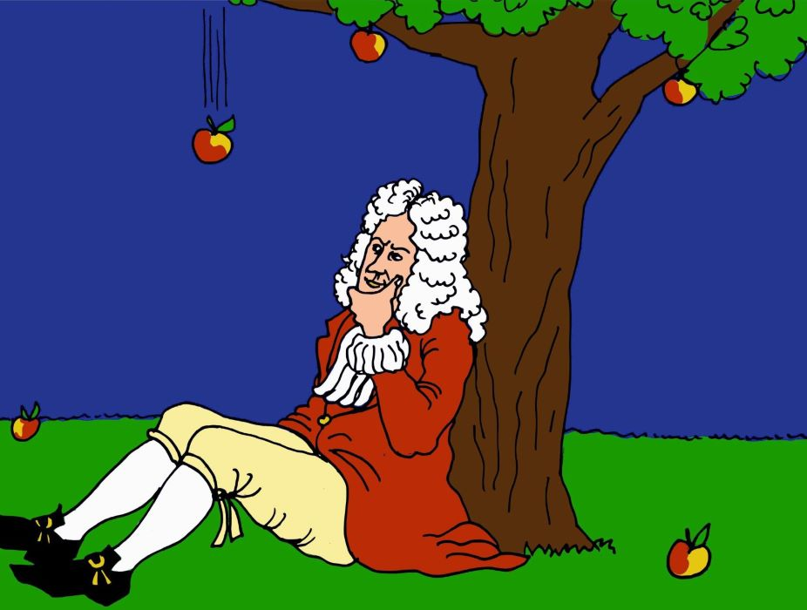
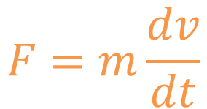
Differential Equations model things that change
Force changes the velocity of an object.
Greater force induces bigger change in velocity.
Newton: The resultant force on a particle is proportional to the rate of change of velocity.
$$F=m\frac{dv}{dt}$$
Image credit: Alexander Borek, CC-BY-SA-4.0
(inertial) mass

Slide 7



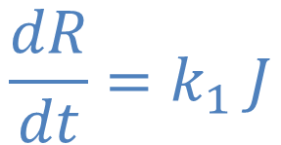

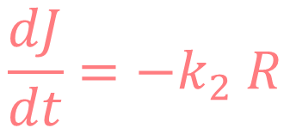
Differential Equations model things that change
Romeo likes Juliet.
Romeo likes Juliet even more when she likes him.
$$\frac{dR}{dt}=k_{1} J$$
$$, k_{1}>0$$
$$\frac{dJ}{dt}=−k_{2} R$$
But Juliet is different.
$$, k_{2}>0$$
Images: Flaticon.com
Love is complicated..

Slide 8
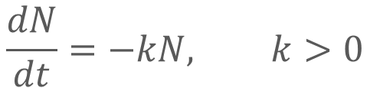


Solving DEs Analytically – Beer foam
$$\frac{dN}{dt}=−kN, k>0$$
$$N(0)=N_{0}$$
$$N=N_{0} e^{−kt}$$
Plot this on Desmos.com
Image: Flaticon.com

Slide 9


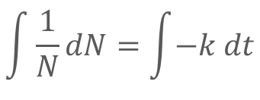


Solving DEs Analytically – Beer foam
$$\frac{dN}{dt}=−kN, k>0$$
$$N(0)=N_{0}$$
$$\int{\frac{1}{N}}dN=\int{−k dt}$$
$$N_{0}={e^{c}e}^{0}=e^{c}$$
$$\ln{N}=−kt+c$$
$$N=N_{0} e^{−kt}$$
$$N=e^{−kt+c}$$
Plot this on Desmos.com
Image: Flaticon.com
$$=e^{c}e^{−kt}$$

Slide 10
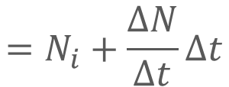
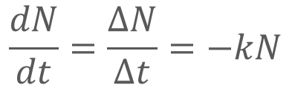



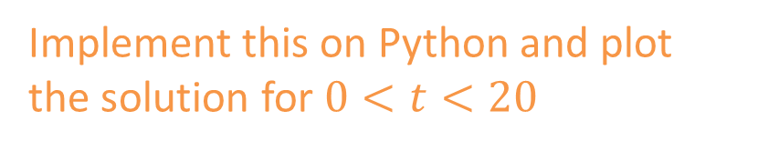


Solving DEs Numerically – Beer foam
$$\frac{dN}{dt}=\frac{ΔN}{Δt}=−kN$$
Numerical scheme (Euler Method):
$$N_{i+1}=N_{i}+ΔN$$
$$N\left(0\right)=N_{0}=1000$$
$$=N_{i}+\frac{ΔN}{Δt}Δt$$
$$k=0.2$$
Image: Flaticon.com
$$=N_{i}−kNΔt$$
$$Δt=0.01$$
Implement this on Python and plot the solution for $0<t<20$

Slide 11
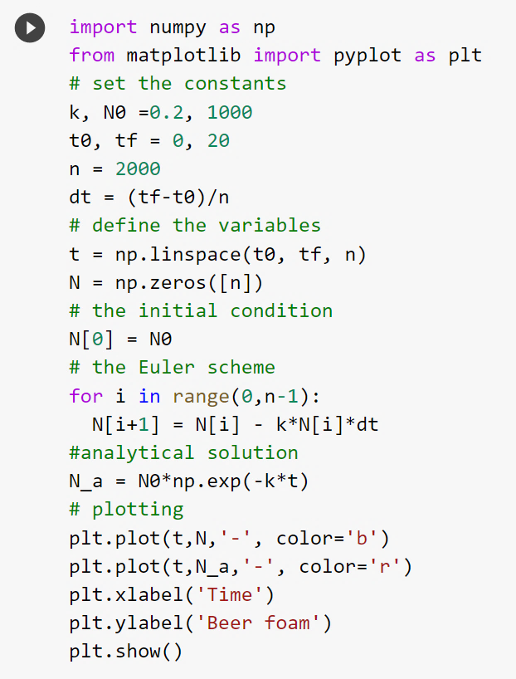
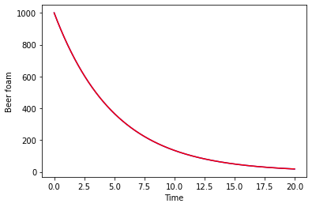






Solving DEs Numerically
Numerical scheme (Euler Method):
$$N_{i+1}=N_{i}−kNΔt$$
Image: Flaticon.com
$$\frac{dN}{dt}=\frac{ΔN}{Δt}=−kN$$
$$N\left(0\right)=N_{0}=1000$$
$$k=0.2$$
$$Δt=0.01$$
$$N=N_{0} e^{−kt}$$

Slide 12


Solving DEs Numerically
Numerical solution
Analytical solution:
$$N=N_{0} e^{−kt}$$
Image: Flaticon.com
$$\frac{dN}{dt}=\frac{ΔN}{Δt}=−kN$$
How accurate is the numerical solution?
Compare it against the analytical solution!
$$N\left(0\right)=N_{0}=1000$$
$$k=0.2$$
$$Δt=0.01$$

Slide 13
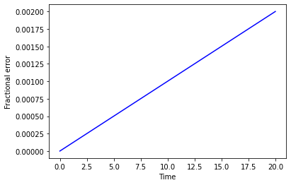
Solving DEs Numerically
Numerical solution
Analytical solution:
$$N=N_{0} e^{−kt}$$
Fractional error $=|\frac{numerical solution − analytical solution}{analytical solution}|$
Image: Flaticon.com
$$\frac{dN}{dt}=\frac{ΔN}{Δt}=−kN$$
Fractional error increases linearly with time.
$$N\left(0\right)=N_{0}=1000$$
$$k=0.2$$
$$Δt=0.01$$

Slide 14
Activity 1 – Foam test
Let’s observe the exponential decrease of beer foam☺
Image: Flaticon.com

Slide 15
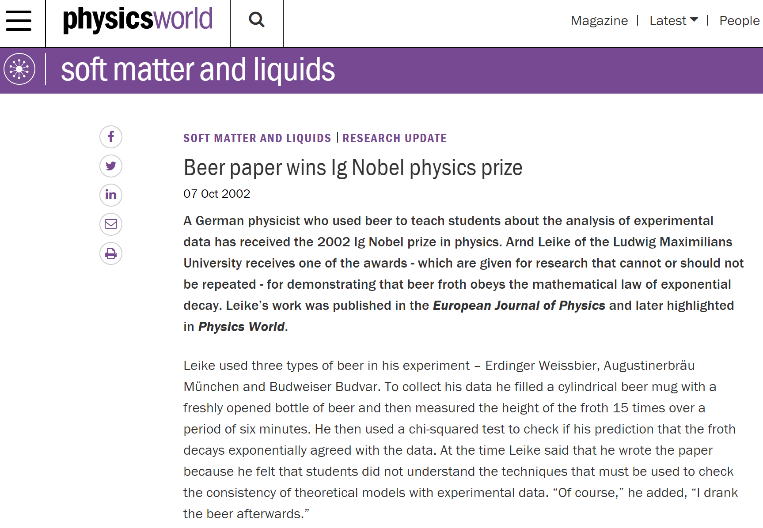

Slide 16


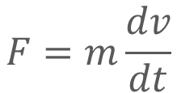
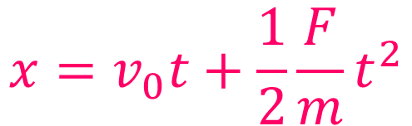

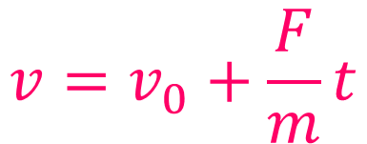
Solving DEs Analytically – Constant force
Image: Flaticon.com
$$F=m\frac{dv}{dt}$$
$${v\left(0\right)=v}_{0}$$
$$v=v_{0}+\frac{F}{m}t$$
$$x=v_{0}t+\frac{1}{2}\frac{F}{m}t^{2}$$
$$x\left(0\right)=0$$

Slide 17
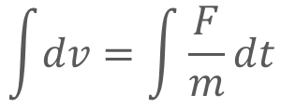
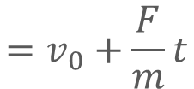
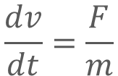
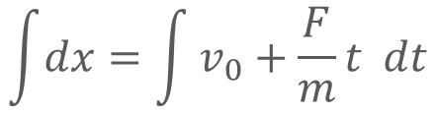

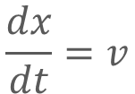

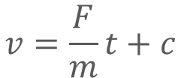
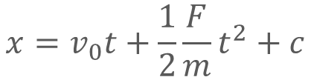
Solving DEs Analytically – Constant force
$$\frac{dv}{dt}=\frac{F}{m}$$
$$\frac{dx}{dt}=v$$
$$=v_{0}+\frac{F}{m}t$$
$$\int{dv}=\int{\frac{F}{m}dt}$$
$$\int{dx}=\int{v_{0}+\frac{F}{m}t dt}$$
Image: Flaticon.com
$$F=m\frac{dv}{dt}$$
$$v=\frac{F}{m}t+c$$
$$x=v_{0}t+\frac{1}{2}\frac{F}{m}t^{2}+c$$
$${v\left(0\right)=v}_{0}=0+c$$
$$x\left(0\right)=0+c=0$$
$${v\left(0\right)=v}_{0}$$
$$v=v_{0}+\frac{F}{m}t$$
$$x=v_{0}t+\frac{1}{2}\frac{F}{m}t^{2}$$
$$x\left(0\right)=0$$

Slide 18

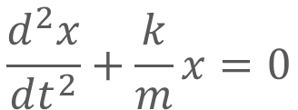
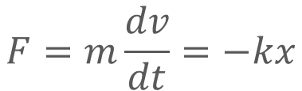

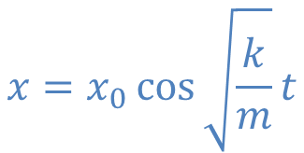

Solving DEs Analytically – Restoring force
Image: Flaticon.com
$$F=m\frac{dv}{dt}=−kx$$
$$\frac{d^{2}x}{dt^{2}}+\frac{k}{m}x=0$$
$${x\left(0\right)=x}_{0}$$
$$x=x_{0}\cos{\sqrt{\frac{k}{m}}t}$$
$$v\left(0\right)=0$$

Slide 19
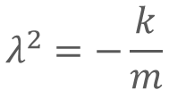

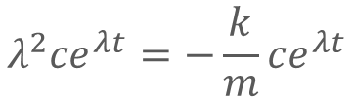

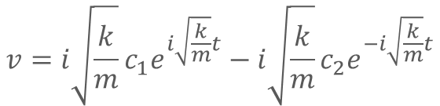
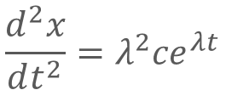
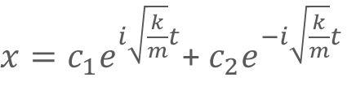
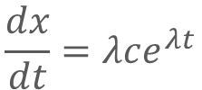
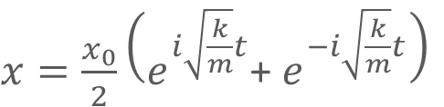
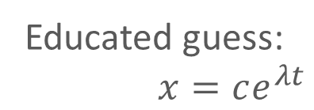

Solving DEs Analytically – Restoring force
$x=c_{1}e^{i\sqrt{\frac{k}{m}}t}$+ $c_{2}e^{−i\sqrt{\frac{k}{m}}t}$
Educated guess:
$x=ce^{λt}$
$$v={i\sqrt{\frac{k}{m}}c}_{1}e^{i\sqrt{\frac{k}{m}}t}−i\sqrt{\frac{k}{m}}c_{2}e^{−i\sqrt{\frac{k}{m}}t}$$
Image: Flaticon.com
$$\frac{dx}{dt}=λce^{λt}$$
$$F=m\frac{dv}{dt}=−kx$$
$$\frac{d^{2}x}{dt^{2}}=λ^{2}ce^{λt}$$
$$v\left(0\right)=0⇒c_{1}=c_{2}$$
$$x\left(0\right)=x_{0}⇒c_{1}=\frac{x_{0}}{2}$$
$$\frac{d^{2}x}{dt^{2}}+\frac{k}{m}x=0$$
$$λ^{2}ce^{λt}=−\frac{k}{m}ce^{λt}$$
$x=\frac{x_{0}}{2}\left(e^{i\sqrt{\frac{k}{m}}t}\text{+ }e^{−i\sqrt{\frac{k}{m}}t}\right)$
$$λ^{2}=−\frac{k}{m}$$
$${x\left(0\right)=x}_{0}$$
$$x=x_{0}\cos{\sqrt{\frac{k}{m}}t}$$
$$v\left(0\right)=0$$
$$λ =±i\sqrt{k/m}$$

Slide 20




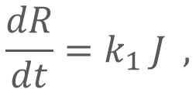
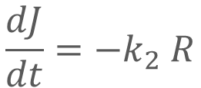
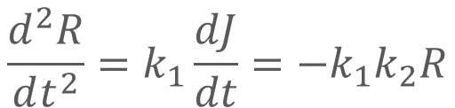
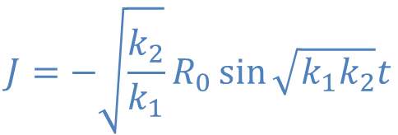

Solving DEs Analytically – Love
$$\frac{dR}{dt}=k_{1} J ,$$
$$\frac{dJ}{dt}={−k}_{2} R$$
$$k_{1},k_{2}>0$$
Image: Flaticon.com
$$R\left(0\right)=R_{0}$$
$$J\left(0\right)=0$$
$$\frac{d^{2}R}{dt^{2}}=k_{1}\frac{dJ}{dt}=−k_{1}k_{2}R$$
Love is not that complicated!
$$J={−\sqrt{\frac{k_{2}}{k_{1}}}R}_{0}\sin{\sqrt{k_{1}k_{2}}t}$$
Go to Activity 2
$$R=R_{0}\cos{\sqrt{k_{1}k_{2}}t}$$
$$\frac{dR}{dt}=−\sqrt{k_{1}k_{2}}R_{0}\sin{\sqrt{k_{1}k_{2}}t}=k_{1}J$$

Slide 21


Activity 2: Love Plot
For some chosen values of $R_{0}$, $k_{1}$ and $k_{2}$, plot $R(t)$ and $J(t)$ on Desmos.
$$R=R_{0}\cos{(\sqrt{k_{1}k_{2}} t)}$$
$$J=−\sqrt{k_{2}{/k}_{1}}R_{0}\sin{(\sqrt{k_{1}k_{2}} t)}$$
Open a new Desmos window and plot $R$ vs $J$
Can you form a conserved quantity using $R$ and $J$?

Slide 22


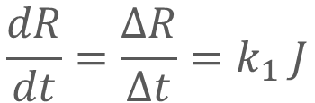


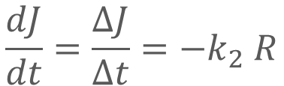


Solving DEs Numerically
$$\frac{dR}{dt}=\frac{ΔR}{Δt}=k_{1} J$$
$$\frac{dJ}{dt}=\frac{ΔJ}{Δt}={−k}_{2} R$$
Image: Flaticon.com
$$R\left(0\right)=R_{0}=1$$
$$J\left(0\right)=J_{0}=0$$
$$k_{1}=1$$
$$k_{2}=0.8$$
Numerical scheme (Euler Method):
$$R_{i+1}=R_{i}+k_{1}{ J}_{i} Δt$$
$$J_{i+1}=J_{i}−k_{2}{ R}_{i} Δt$$
Implement this on Python and plot the solutions for $0<t<20$

Slide 23










Solving DEs Numerically
Euler Method:
$$R_{i+1}=R_{i}+k_{1}{ J}_{i} Δt$$
$$J_{i+1}=J_{i}−k_{2}{ R}_{i} Δt$$
Image: Flaticon.com
$$\frac{dR}{dt}=\frac{ΔR}{Δt}=k_{1} J$$
Euler-Cromer Method:
$$R_{i+1}=R_{i}+k_{1}{ J}_{i} Δt$$
$$\frac{dJ}{dt}=\frac{ΔJ}{Δt}={−k}_{2} R$$
$$J_{i+1}=J_{i}−k_{2}{ R}_{i+1} Δt$$
$$R\left(0\right)=R_{0}=1$$
$$J\left(0\right)=J_{0}=0$$
In 1981, Cromer chanced upon a slight modification to Euler’s method that doesn’t seems like much, but….
$$k_{1}=1$$
$$k_{2}=0.8$$
Go to Activity 3

Slide 24
Activity 3
Solve the case of love numerically with
Euler method,
Euler-Cromer method (week 3 IS)
Compare each of the numerical solutions with the analytical solutions.
Also use the conserved quantity to compare the two numerical methods.

Slide 25




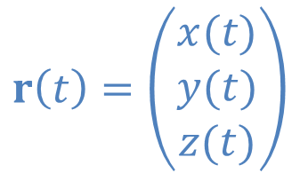

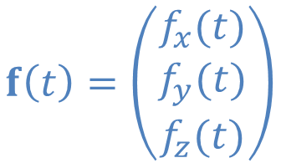




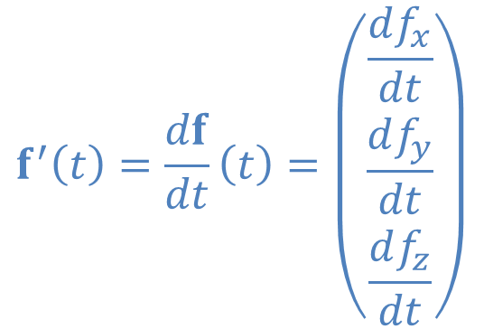
On vectors.. – Week 3 IS
$$r\left(t\right)=\left(\begin{matrix}x(t) \\ y(t) \\ z(t)\end{matrix}\right)$$
Location of a particle at time $t$
$$a+b$$
Position vector
Vector addition
$$b$$
$$a$$
$$f\left(t\right)=\left(\begin{matrix}f_{x}(t) \\ f_{y}(t) \\ f_{z}(t)\end{matrix}\right)$$
Vector function
$$−a$$
-a opposite direction to a
$$f^{′}\left(t\right)=\frac{df}{dt}\left(t\right)=\left(\begin{matrix}\frac{df_{x}}{dt} \\ \frac{df_{y}}{dt} \\ \frac{df_{z}}{dt}\end{matrix}\right)$$
$$−a$$
$$b−a=b+(−a)$$
$$b−a$$
$$b$$

Slide 26






The Earth and the Sun, a two-body system – Week 3 IS
Fill in the following:
Radius of the Sun $R$:
Average distance from Sun to Earth $R_{e}$:
Mass of the Sun $M_{s}$:
Mass of the Earth $M_{e}$:
Gravitational constant $G$:
Linear momentum of Earth $p_{e}$:
We can get this by knowing that Earth circles abound the Sun in 365 days. How??

Slide 27
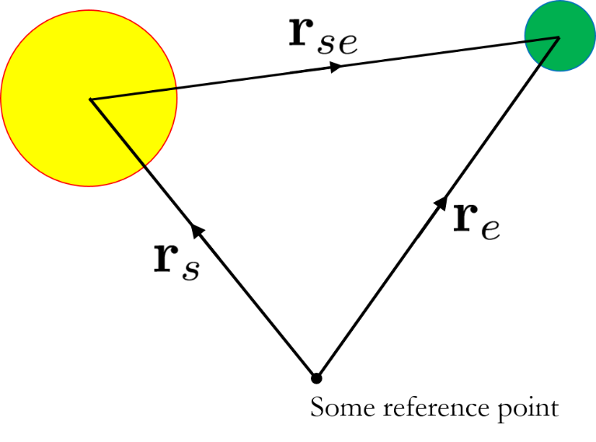


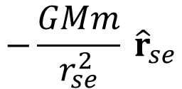



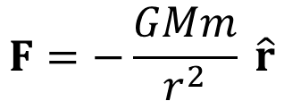
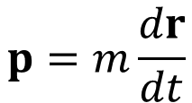


The Earth and the Sun, a two-body system – Week 3 IS
Setting up the position vectors
Differential equations
Define the forces
$$F=\frac{dp}{dt}$$
$$p=m\frac{dr}{dt}$$
$$F=−\frac{GMm}{r^{2}} \hat{r}$$
Numerical schemes
$$−\frac{GMm}{r_{se}^{2}} {\hat{r}}_{se}$$
$$F_{se}=$$
$p_{i+1}=$ $p_{i}+F_{i}dt$
$$r_{se}=$$
$$r_{e}−r_{s}$$
$$F_{es}=−F_{se}$$
$r_{i+1}=$ $r_{i}+\frac{1}{m}p_{i}dt$
Go to Activity 4 (lecture notes)

Slide 28
Notable “discoveries” for a two-body system – Week 3 IS

Slide 29
Discussion question 1
Give some more examples of how differential equations are used to model stuffs in science.

Slide 30
Discussion question 2
What is the benefit of solving the planetary motion problem numerically?
What is the benefit of solving the planetary motion problem analytically
(For the latter, see for example https://brilliant.org/wiki/deriving-keplers-laws/) ?

Slide 31
Discussion question 3
Other than angular momentum, is there another conserved quantity for planetary orbit?

Slide 32

Discussion question 4
Study the comic. Do you understand it?

Slide 33
Discussion question 5
The previous application of centrifugal force is rather sadistic. A nicer application is the centrifuge machine. Explain how the centrifuge is able to separate particles of different sizes and masses.

Slide 34
10min Pre-lect hw & intro S1-4
05min DE models S5-7
05min Beer analytical S8-9
10min Beer numerical S10-13
05min Beer demo S14-15
05min constant force analytical S16-17
05min break (45min cumulative)
10min restoring force analytical S18-19
10min Love analytical S20-21
10min Love numerical S22-23

